Slide 1
Internet Telephony
Prepared By: Er. Amit Kr. Tewari
Associate Professor
CS Dept.
ACEIT, Jaipur

Slide 2
Basics
Internet telephony, also called Internet Protocol (IP) telephony or Voice over Internet Protocol (VoIP), uses the Internet to carry digital voice telephone calls.
VoIP, in effect, for the most part, bypasses the existing telephone system, but not completely.
VoIP is a highly complex digital voice system that relies on high-speed Internet connections from cable TV companies, phone companies supplying DSL, and other broadband systems including wireless.
It uses the Internet’s vast fiber-optic cabling network to carry phone calls without phone company charges.

Slide 3
VoIP Fundamentals
There are two basic parts to an IP phone call:
The “dialing” process, which establishes an initial connection, and the voice signal flow.

Slide 4
Voice Signal Flow
The voice signal is first amplified and digitized by an analog-to-digital converter (ADC) that is part of a coder-decoder (codec) circuit, which also includes a digital-to-analog converter (DAC).
The ADC usually samples the voice signal at 8 kHz and produces an 8-bit word for each sample.
These samples occur one after another serially and therefore produce a 64-kbps digital signal.
A relatively wide bandwidth is needed to transmit this bit stream (64 kHz or more).

Slide 5
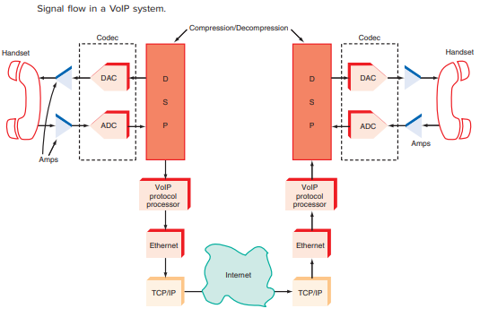

Slide 6
Voice Signal Flow (Contd…)
To reduce the data rate and the need for bandwidth, the bit stream is processed by a voice encoder that compresses the voice signal.
This compression is usually done by DSP either in a separate DSP processor chip or as hardwired logic on a larger chip.
The 64-kbps digital signal is designated as standard G.711 and is better known as pulse-code modulation (PCM),

Slide 7
Voice Signal Flow (Contd…)
The resulting serial digital signal is put into a special packet by a microcomputer processor running a VoIP protocol and then transmitted by Ethernet over a LAN or via a high-speed Internet connection such as is available from a cable TV company or on DSL.
From there the signal travels over standard available Internet connections using TCP/IP through multiple servers and routers until it comes to the desired location.
At the receiving phone, the process is reversed.
The Internet signal gets converted back to Ethernet, and then the VoIP processor recovers the original packet.
From there, the compressed data is extracted, decompressed by a DSP, and sent to the DAC in the codec where the original voice is heard.

Slide 8
Voice Signal Flow Draw Backs
It takes a relatively long time to transmit the voice data over the Internet.
The packets may take different routes through the Internet.
They all do eventually arrive at their intended destination, but often the packets are out of sequence.
The receiving phone must put them back together in the correct sequence. This takes time.

Slide 9
Link Establishment
In Internet telephony, There is no temporary dedicated link is established because of the packetized nature of the system.
Yet some method must be used to get the voice data to the desired phone.
This is taken care of by a special protocol developed for this purpose.
The initial protocol used was the ITU H.323.
Today, however, a newer protocol established by the Internet Engineering Task Force (IETF) called the session initiation protocol (SIP) has been adopted as the de facto standard.
In both cases, the protocol sets up the call and then makes sure that the voice packets produced by the calling phone get sent to the receiving phone in a timely manner.

